Slide 1
Modelling the visibility of deep-sky objects
Dr Andrew Crumey
Northumbria University

Slide 2
Human Contrast Threshold and Astronomical Visibility
arxiv.org/abs/1405.4209
Monthly Notices of the Royal Astronomical Society, Volume 442, Issue 3, p.2600-2619
Google “crumey contrast”

Slide 3
The problem
What is the faintest star or DSO you would expect to see
with naked eye
or telescope at various magnifications,
under various conditions of sky darkness?
This could help us understand
the practical meaning of “dark sky”,
the historic growth of light pollution,
the achievements of visual astronomers.

Slide 4

What do we mean by “brightness”?
This looks smaller, not dimmer
This gives more light

Slide 5
Two kinds of brightness
The surface brightness is the same for both
The apparent magnitude is greater for this one

Slide 6
Photometry | Unit | Astronomy | Unit
Illuminance | lx | Apparent magnitude | mag
Luminance | cd/m² | Surface brightness | mag/arcsec²
Photometric units are linear, and higher means brighter
Astronomical units are logarithmic, and higher means fainter
Sky Quality Meter gives “SQ” reading in mag/arcsec²

Slide 7


We see because of contrast
Colour
Surface brightness

Slide 8

Visibility depends on size and surface brightness

Slide 9
Blackwell (1946)
Uniform circular target projected on illuminated screen.
Target in one of several possible positions.
Subjects indicate position using a keypad.
Threshold defined as 50 per cent success.
Study extended to larger targets by Taylor (1960).

Slide 10
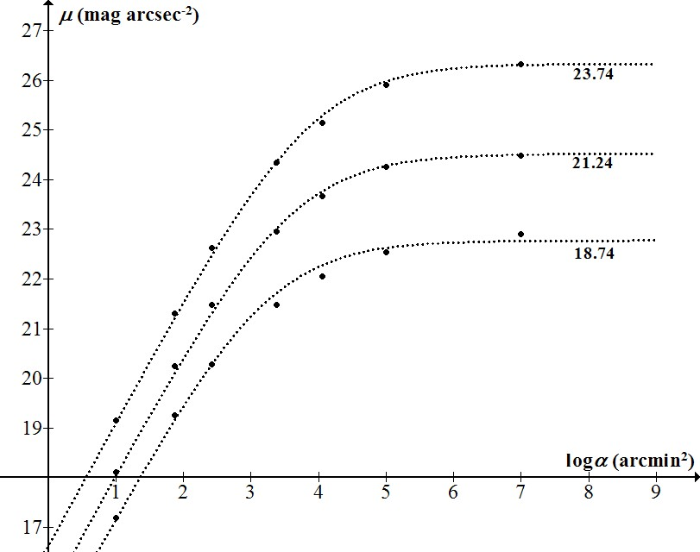
Blackwell-Taylor data in astronomical units, for three (low) levels of background. Curves from model.
A target on curve is 50% likely to be seen.
Below curve: more than 50% likely.
Above: less than 50%.

Slide 11
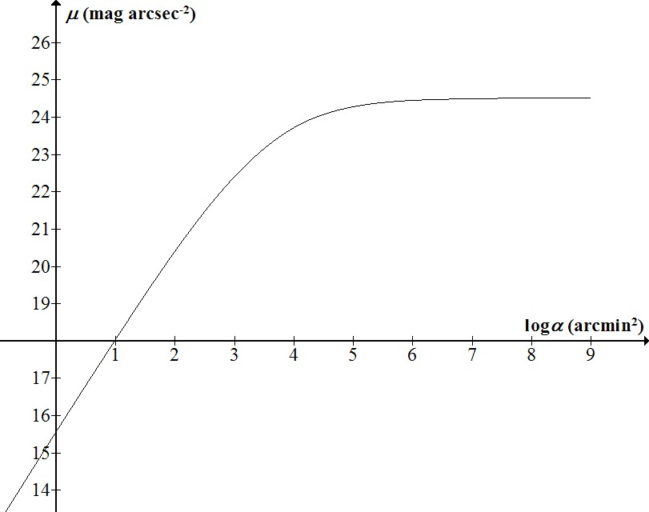
A typical curve -
asymptotic at both ends

Slide 12
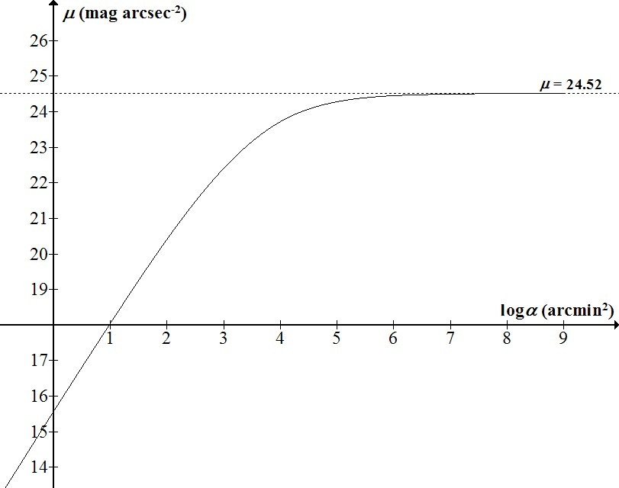
Limiting surface brightness
(at 50% detection probability)
for very large targets

Slide 13
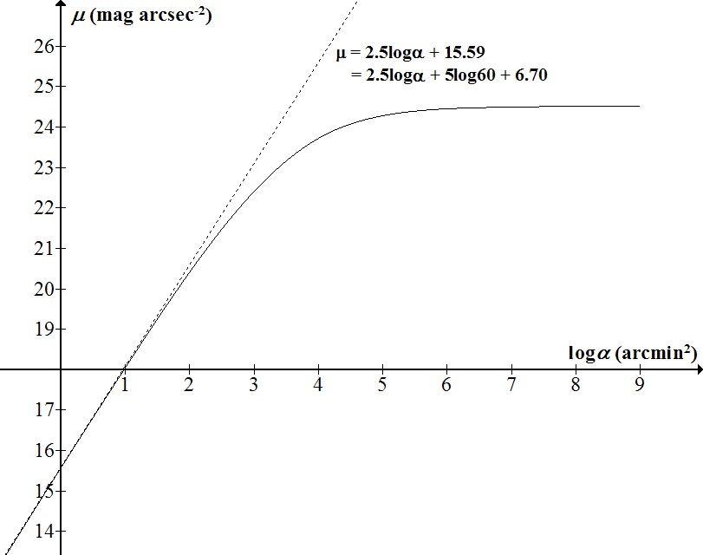
Limiting magnitude
(at 50% detection probability)
For very small targets

Slide 14
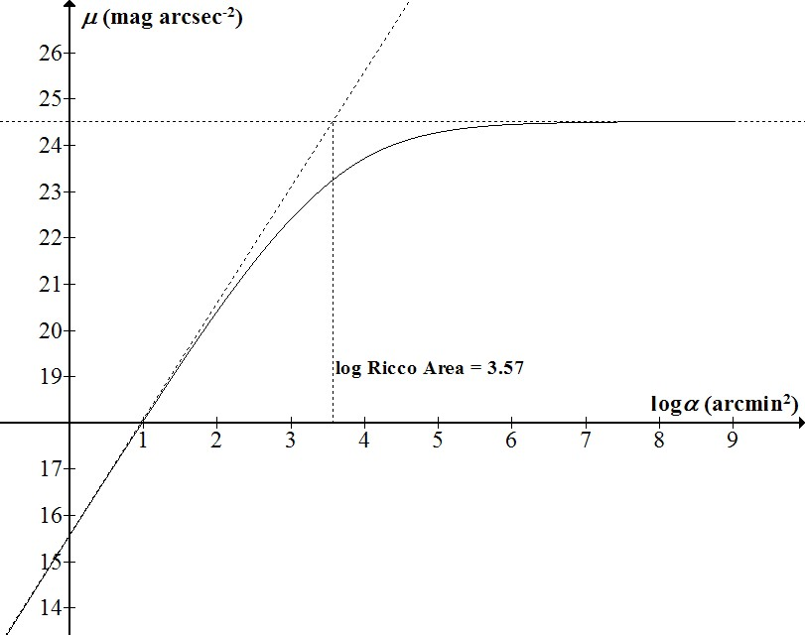
For targets smaller than the Ricco area, apparent magnitude is best indicator of visibility. For targets larger than Ricco area, surface brightness is best indicator.

Slide 15
The F-Factor
Blackwell’s curves are “theoretical” (50% detection probability)
For realistic threshold (>90%) they need to be adjusted
Also variation between individuals (age, acuity etc)
Factors for actual viewing conditions (e.g. atmosphere)
All can be accounted for as multipliers: overall factor F
Effect on log axes is to move the curve up or down

Slide 16
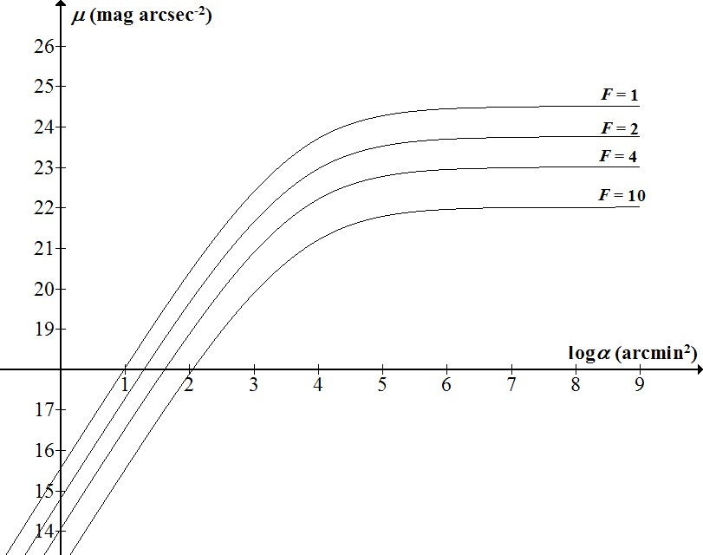
The “field factor” F is a product of multipliers corresponding to:
Detection probability;
Observer (age, acuity, motivation…);
Target attributes (shape);
Viewing conditions (atmosphere, glare…).
Not all known in general.
So threshold is relative not absolute.

Slide 17
Deductions from the model
Limiting magnitude:
m₀ = 0.3834μ_{sky} – 1.4400 – 2.5logF
for 20 < μ_{sky} < 22 mag arcsec⁻²
Limiting surface brightness:
μ∞ = 0.6864μ_{sky} + 9.9325 – 2.5logF
for 18 < μ_{sky} < 22 mag arcsec⁻²

Slide 18
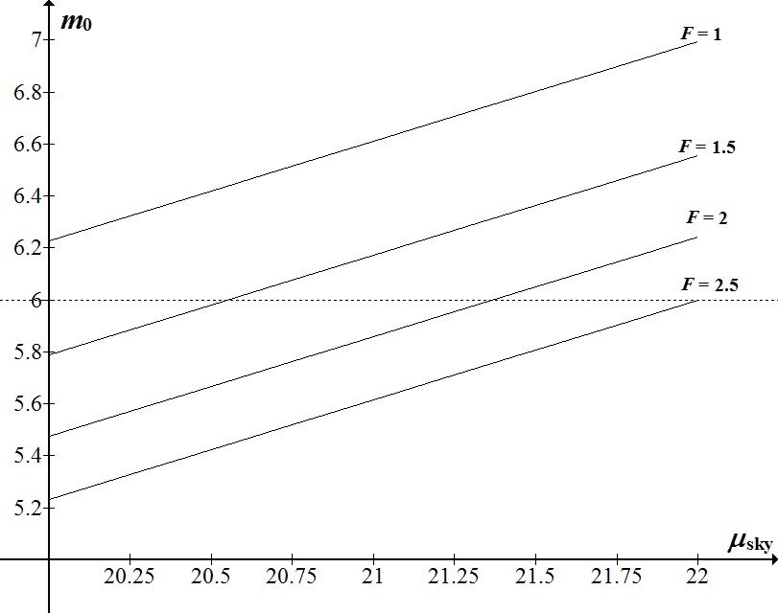
Stellar magnitude limit as a function of sky brightness, for various values of field factor F.
F = 2.5 gives traditional dark-sky limit 6 mag.

Slide 19
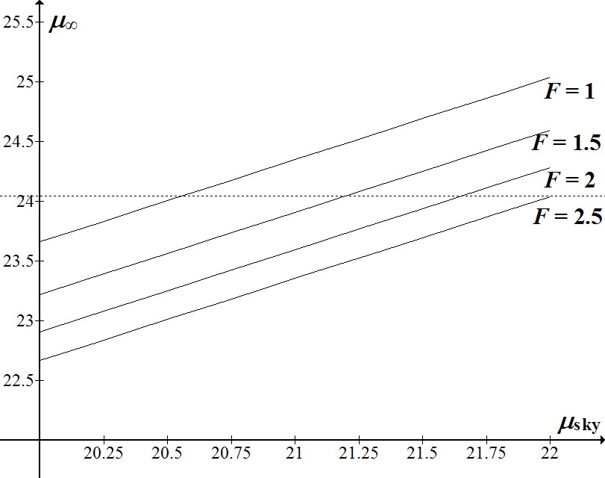
Stellar limit 6 mag (F=2.5) corresponds to large-target surface brightness limit approximately 24 mag/arcsec²

Slide 20
Telescopic threshold
A telescope offers a gain in magnitude limit but a reduction in surface brightness limit.
The threshold curve changes shape as magnification increases.
A DSO may be invisible at low power (too small) and high power (too faint), but visible at medium magnification.
New factors that must be taken into account (e.g. transmittance, monocular vision).
Caution: DSOs are not uniform discs!

Slide 21
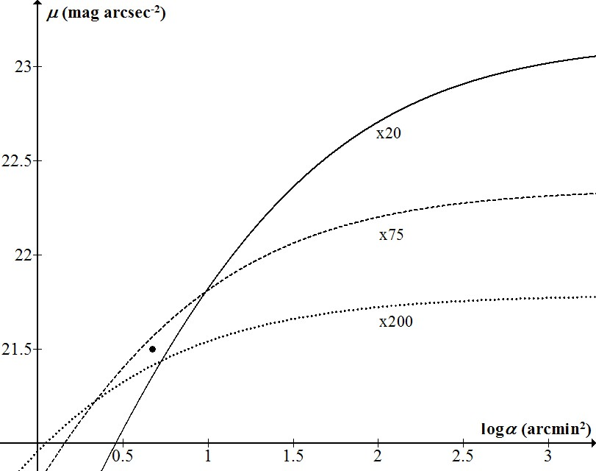
Threshold curves for a 100mm refractor at various magnifications.
(95% transmittance, observer with 6mm eye pupil and F=2.)
Target (data point) is predicted visible at x75 but invisible at the lower or higher powers.

Slide 22
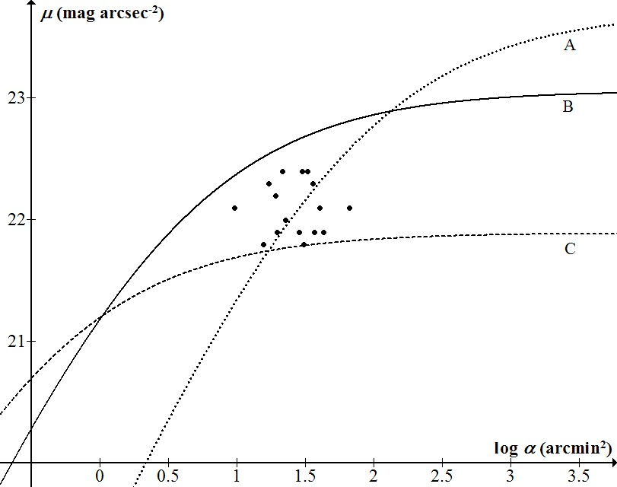
A: 10x50 binoculars, dark site
B: 6” refractor, dark site
C: 16” reflector, light-polluted site
Data points: Messier galaxies in Virgo Cluter
Dark site: 21.5 mag/arcsec²
Bright site: 20 mag/arcsec²
Exit pupil 3mm for both scopes
Transmittances 85%, 95%, 75%
Reflector with 25% central obstruction
Observer 7mm eye pupil, F=2

Slide 23
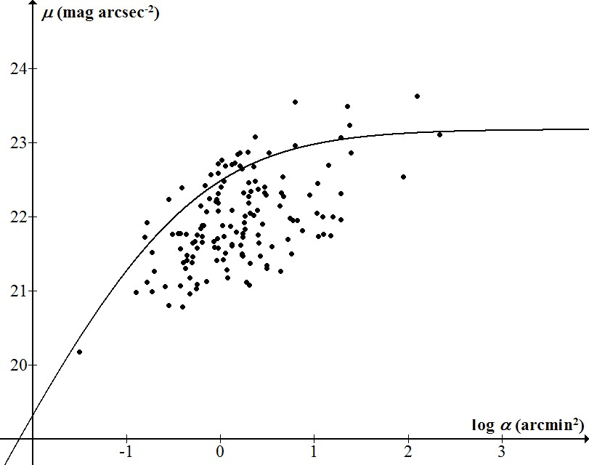
Objects discovered by William Herschel, dec ≥60°
Herschel’s threshold curve calculated from his recorded parameters, and assumed sky brightness 21.83 mag arcsec⁻².
Aperture 18.7 inches
Transmittance 63%
Exit pupil 3.03mm (x 157 power)
Eye pupil 5.1mm
Naked-eye limit 6.0 (for B-V 0.85)
F = 2.36

Slide 24
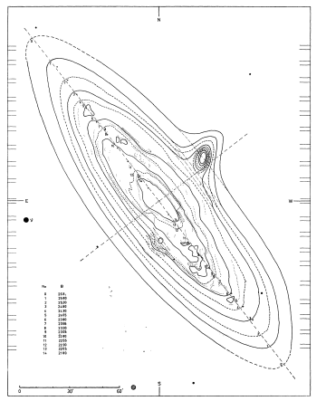
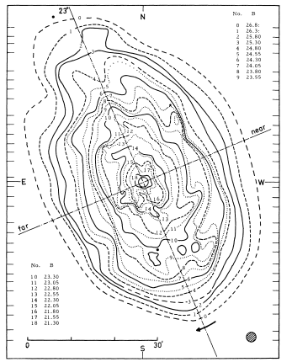
What stellar magnitude limit is required in order for M31 or M33 to be visible to the naked eye?
M31 isophotes to 25.9 mag/arcsec²
Total magnitude 3.5
(De Vaucouleurs 1958)
M33 isophotes to 25.3 mag/arcsec²
Total magnitude 5.9
(De Vaucouleurs 1959)

Slide 25
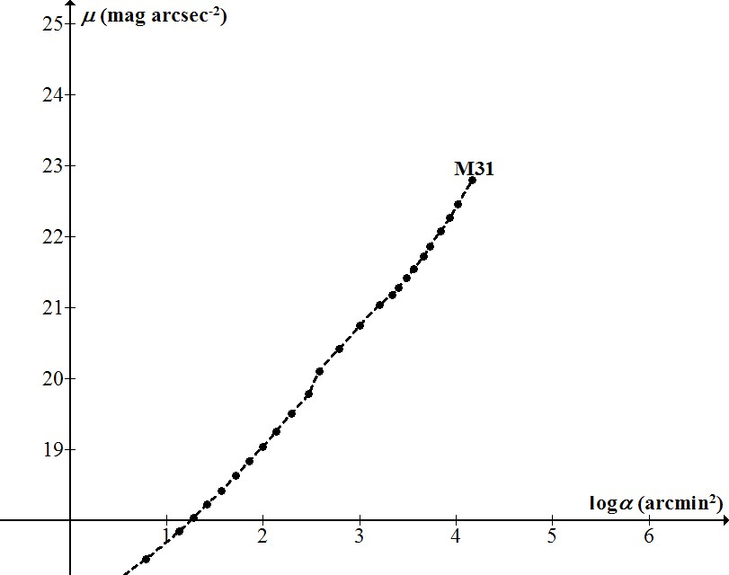
Surface brightness of M31 measured within successive isophotes.
Data from de Vaucouleurs (1959)

Slide 26
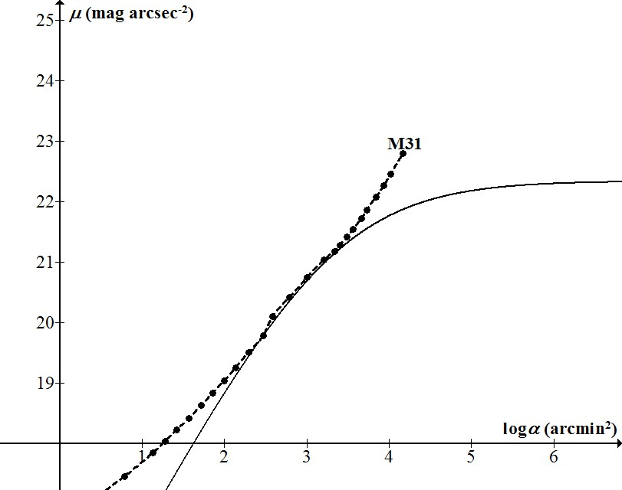
Threshold curve such that M31 is estimated to be just visible.
It corresponds to F=2, background
19.2 mag/arcsec².

Slide 27

The asymptote to the threshold curve gives the stellar magnitude limit as 5.2.
This is the “effective magnitude” of the galaxy, fainter than the measured total magnitude 3.5.

Slide 28
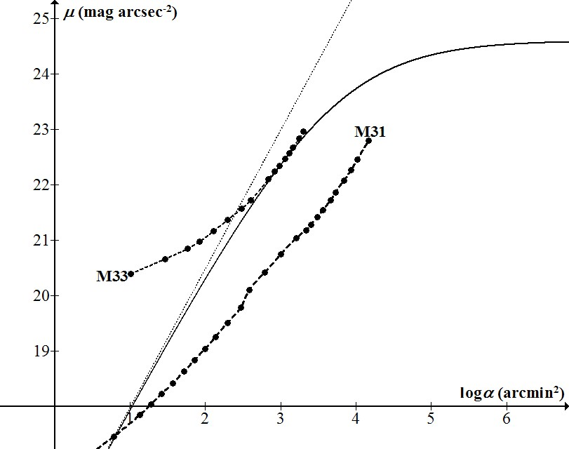
For M33 the same procedure gives effective magnitude 6.6, compared with total magnitude 5.9.
This is consistent with visual estimates:
Heis (1872) 6.7
Holetschek (1907) ≈7 Weaver (1947) 6.8.

Slide 29
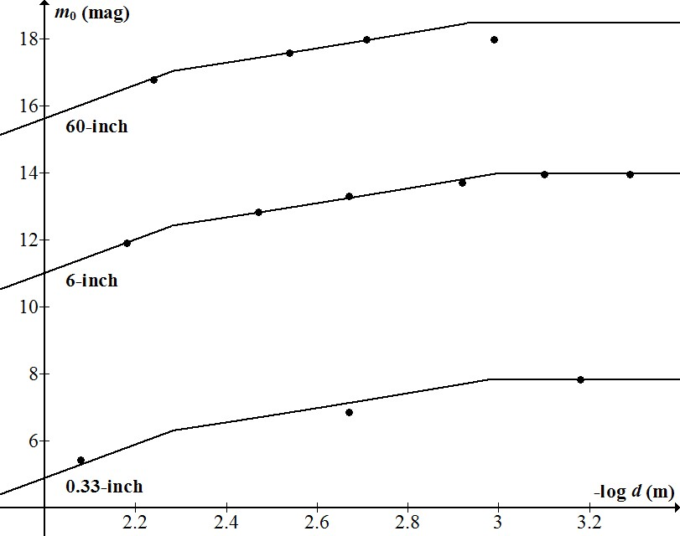
Bowen (1947): magnitude limit with three telescopes at different magnifications.
If transmittance of smallest scope is estimated as 90±5%, then all other parameters are deduced from the model.
Anomalous 60-inch point due to over-magnification enables seeing to be calculated.
Sky brightness 21.27 mag/arcsec², (≈21.6 mag/arcsec² zenith).
Seeing 1.1 arcsec.
60-inch mirror: 85% reflectance.
Bowen’s pupil diameter: 5.2mm

Slide 30
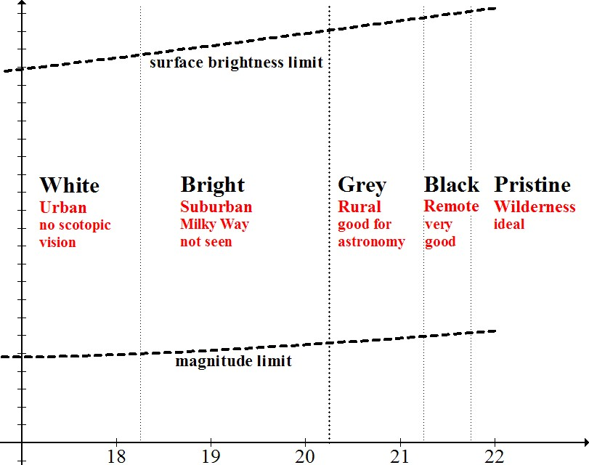

Slide 31
Human Contrast Threshold and Astronomical Visibility
arxiv.org/abs/1405.4209
Monthly Notices of the Royal Astronomical Society, Volume 442, Issue 3, p.2600-2619
Google “crumey contrast”

