Slide 1
What Will I See?
Modelling astronomical visibility
Dr Andrew Crumey
Northumbria University

Slide 2
Things people ask…
What should I be able to see with my telescope?
What if I get a larger one instead?
How much aperture do I need to see galaxies clearly?
Should I buy a big telescope and put it in my light-polluted garden, or a smaller one I can take to a dark site?

Slide 3
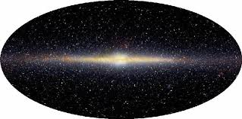
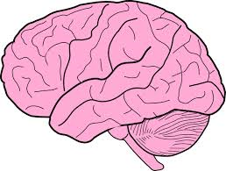

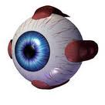
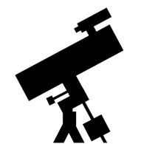
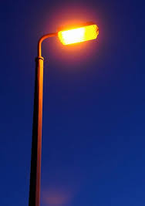
The Great Chain
Sky
Telescope
Visual system

Slide 4
What will I see?
Depends on the sky
Depends on the telescope
Depends on the visual system

Slide 5


We see because of contrast
Colour
Brightness

Slide 6
The visual system
Photopic (daylight). Uses “cone” cells on retina. Sensitive to brightness and colour.
Scotopic (dark night). Uses “rod” cells. Sensitive only to brightness. In low light levels we are all colour blind.
Mesopic (twilight, light polluted). Uses both rods and cones. Able to distinguish colours.
If we can see colour through a telescope we are using mesopic vision. When viewing very faint (“threshold”) targets at a dark site we use scotopic vision.

Slide 7
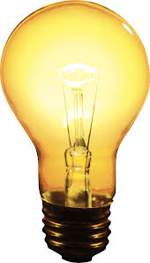
What do we mean by “brightness”?
The more distant lamp gives us less light.
But we do not perceive the lamp itself as being dimmer, just smaller.
It has less “total brightness” but the same “brightness per unit area”.

Slide 8
Two kinds of “brightness”
The illumination we receive from the source: illuminance.
The “brightness per unit area” of the source itself: luminance.
Illuminance decreases with distance.
Luminance stays the same.
In astronomical terms, illuminance corresponds to apparent magnitude.
Luminance corresponds to surface brightness.

Slide 9
Photometry | Unit | Astronomy | Unit
Illuminance | lx | Apparent magnitude | mag
Luminance | cd/m² | Surface brightness | mag/arcsec²

Slide 10
Apparent magnitude depends on distance (the further the source, the fainter the magnitude).
Surface brightness is independent of distance.
A telescope makes things look closer (bigger).
It can make things brighter in apparent magnitude.
It cannot increase surface brightness (in general it decreases it).

Slide 11

Visibility depends on size and luminance

Slide 12
If we try to read in low light we need larger print.
For something to be visible at low light levels it needs to be large enough.
If we want to see a faint galaxy against the sky we need to magnify it sufficiently.

Slide 13
What a telescope does
The telescope captures more light than the naked eye (because of its larger aperture).
This means the illumination from a source (illuminance or magnitude) is greater once it has passed through the telescope.
The target looks larger.
But the luminance (surface brightness) of the source is not increased. In general it is reduced.

Slide 14
Stars
Stars are point sources.
A telescope does not make stars look bigger (as long as magnification is not excessive).
It just gives us more illumination from them (makes them look brighter).
But the telescope magnifies the background sky, reducing its surface brightness (making it look darker).
So stars have greater contrast and become more easily visible.

Slide 15
DSOs (galaxies, nebulae)
DSOs are extended sources. A telescope makes them look bigger, giving us more illumination.
But their luminance (surface brightness) is in general decreased.
The same thing happens to the background sky.
So the contrast of the target against the background is unchanged.
But at low levels, objects need to be large enough in order to become visible.
If we can make the target big enough, without reducing its surface brightness too much, then it will be visible.

Slide 16
Example 1
Suburban site. M31 is visible in binoculars but not naked eye.
Reason:
M31 and the sky both have a certain luminance (surface brightness), hence some value of contrast (call it C).
Seen through binoculars, the contrast is still C.
But the binoculars make the galaxy large enough to be visible.

Slide 17
Example 2
Dark site. M31 is easily visible to the naked eye.
Reason:
M31 has the same luminance (surface brightness) that it always has, but the sky is darker, so there is a bigger contrast (call it C’).
At that contrast level it does not need to be so large to be visible.
It is already big enough to be seen with the naked eye.

Slide 18
What this is telling us
If we want to look at DSOs then the most important thing is the object’s contrast against the sky.
The object’s luminance (surface brightness) is fixed, the sky’s isn’t.
So the most important thing is the brightness (darkness) of the sky.

Slide 19
Aperture is not king
No telescope, no matter how big the aperture, will show galaxies in daylight.
But if the sky is dark enough we can see galaxies easily, even without a telescope if they are large enough.
A telescope just makes them bigger.
If the telescope is big then it enables us to magnify more, without too much loss of surface brightness.
So a big telescope will show more galaxies (and details in galaxies), as long as the sky is dark enough to begin with.

Slide 20
The general rule
At any given site, a larger scope beats a smaller one at showing faint targets.
But a small scope at a dark site will generally beat a larger one at a brighter site.
For visual astronomy it is often better to spend money on petrol rather than aperture.

Slide 21
Modelling visibility
Hecht (1934): theoretical formula for faintest point source visible against a given background brightness. Based on theory of retinal chemistry.
Knoll, Tousey and Hulbert (1946): laboratory experiments where subjects looked at artificial stars.
Hecht (1947): showed his formula fitted the data rather well.

Slide 22
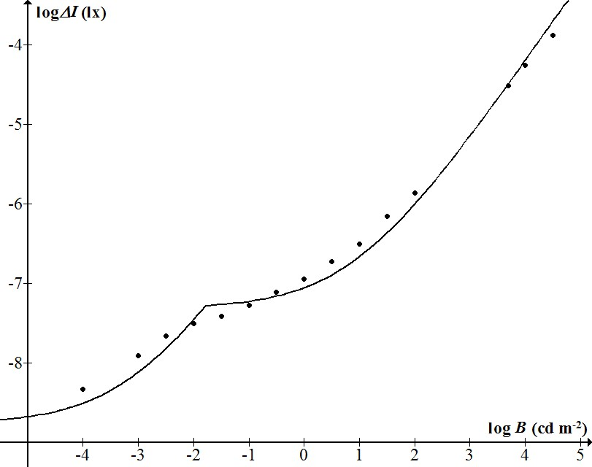
Model versus data

Slide 23
Schaefer (1990) used Hecht’s formula as a model of stellar limiting magnitude. It is the basis for most online calculators.
But Hecht’s theory of vision was incorrect.
His formula was not very accurate.
Schaefer made some errors.
So a better model is needed.

Slide 24
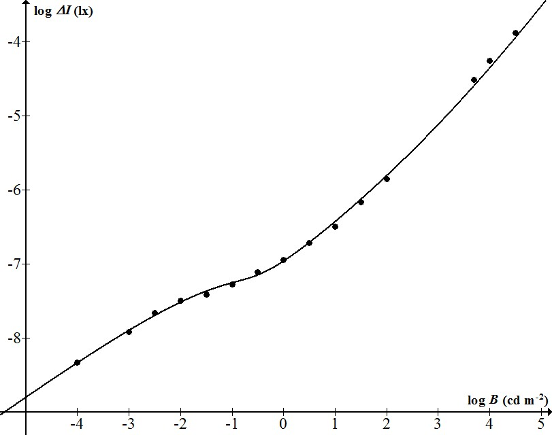
A better model
Hecht (1947)
Crumey (2014)

Slide 25
Hecht’s model only applied to point sources (stars).
Need a model that would also apply to extended targets (DSOs).
Blackwell (1946) obtained laboratory data for subjects viewing uniform discs against backgrounds at different brightness levels.
Various people have tried to model that data and apply it to astronomy, e.g. Clark (1990), Garstang (1999).
Those models have problems.

Slide 26
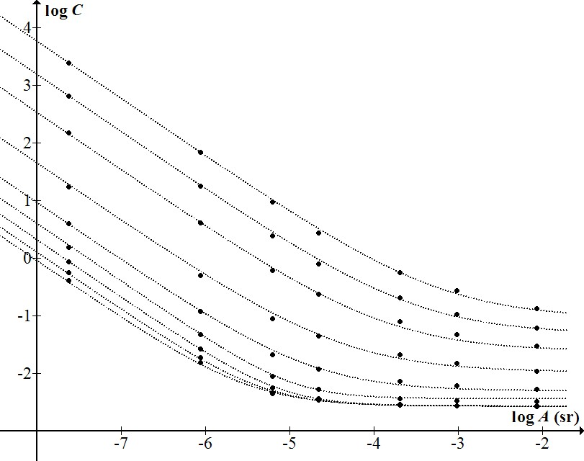
Constrast threshold as a function of target area.
Figure from Crumey (2014) showing my model (dotted curves) against the data of Blackwell (1946).
Each curve is for a different background level, ranging from bright daylight (bottom) to darkest night (top).

Slide 27
The formulas for these curves are messy, but they are based on a simple finding to do with “Ricco’s law”.
Ricco’s law says that for faint targets (near threshold), it is hard to distinguish extended sources from point ones.
So for example, a faint star might be mistaken for a small DSO, or vice versa.
I found a formula for Ricco’s law as a function of background luminance, and this gave me a way of constructing my general model.

Slide 28
But I also wanted to apply my model to telescopic viewing.
That meant I had to modify my (messy) formulae to take account of the change of size and illuminance that a telescope introduces, as well as light loss etc.
I tested my model against visual observations by professional astronomers.

Slide 29
Test 1: Bowen (1947)
He was director of Mount Wilson Observatory.
He found his own limiting magnitude for stars viewed through three telescopes at different magnifications.
By fitting my model to the data for one telescope I was able to work out unknown parameters such as sky brightness, acuity, eye-pupil size, telescope transmittances.
I found it most useful to work in terms of exit pupil rather than magnification.

Slide 30
Exit pupil
The disc of light cast on the observer’s own eye.
Exit pupil diameter = aperture/magnification
Graph of stellar limit has three sections:
  Exit pupil > eye pupil diameter
  Exit pupil < eye pupil diameter
  Final limit: either the background is so dark as to be effectively zero, or else magnification renders stars no longer point-like.

Slide 31
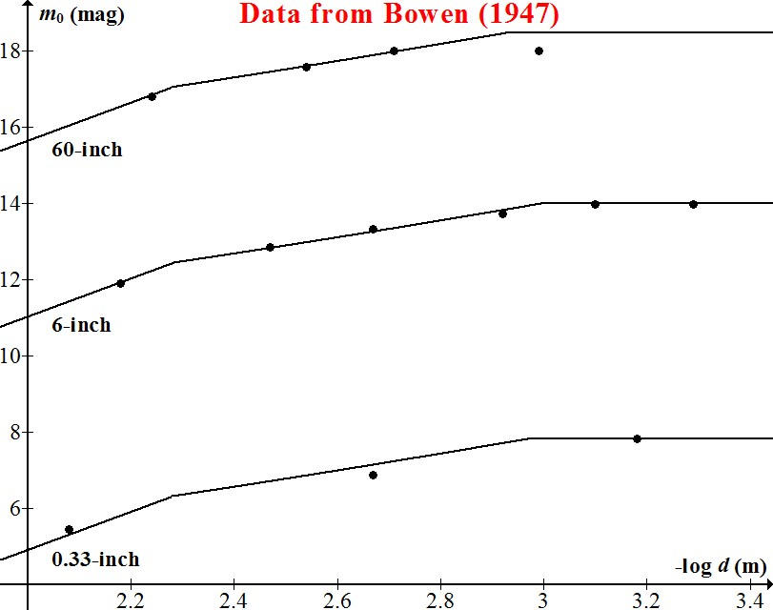

Slide 32
Deductions
Bowen’s pupil diameter: 5.2mm (consistent with age 49 years)
Bowen’s naked-eye limit: 5.58-5.66 mag
Seeing: 1.1 arcsec
60-inch mirror reflectance: 85%
Background sky: 21.27 ± 0.06 mag/arcsec².
Zenith sky: 21.6 mag/arcsec² approx.

Slide 33
Test 2: William Herschel
I searched Herschel’s papers for details about his observing methods, telescope, measurements etc.
This enabled me to predict his “telescopic threshold curve” using my model.
I collected modern astrophysical data on Herschel’s catalogue of approximately 2500 DSOs.
I plotted surface brightness against angular size, to compare the data with his predicted threshold curve.

Slide 34
Herschel data
Eye pupil: 0.2 inches (5.08 mm)
Naked-eye limit: 5.9-6.1 mag
Telescope aperture: 18.7 inch
Magnification: 157
Telescope transmittance: 63.8%

Slide 35
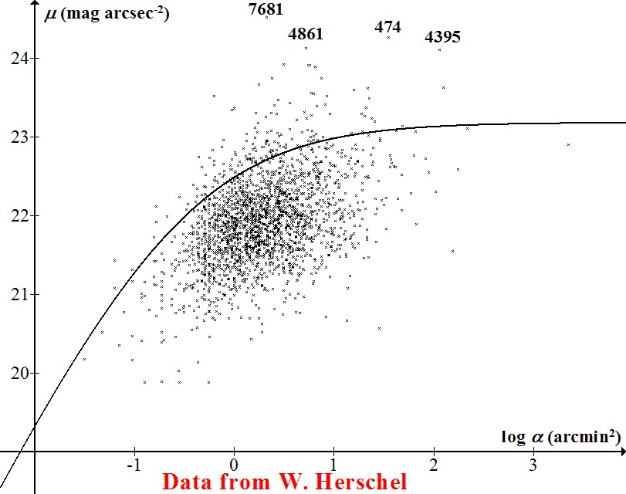
µ = 23.18 − 4.167log(0.468α^{−0.6} + 1)
2136 objects plotted
92% lie below the curve

Slide 36
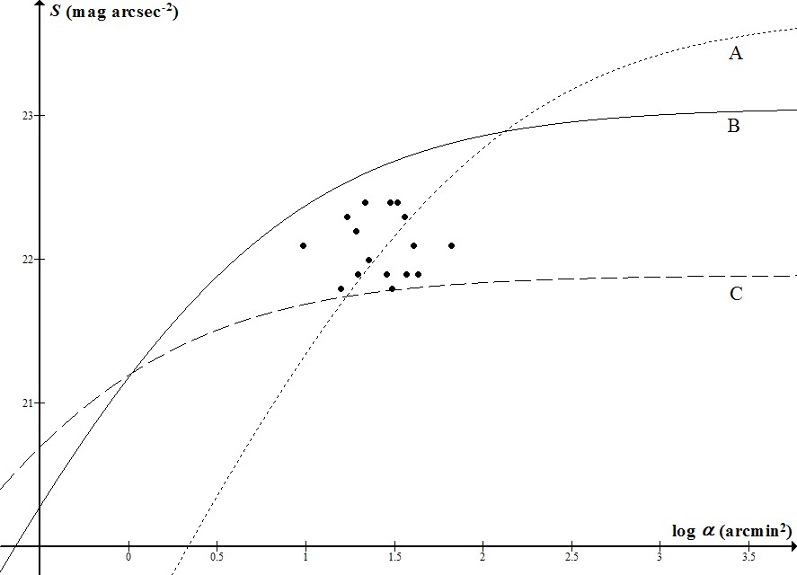
10x50 bins
dark site SQ 21.5
6-inch refractor
dark site SQ 21.5
exit pupil 3mm
16-inch reflector,
light polluted site SQ 20
exit pupil 3mm
Data points are Messier galaxies in Virgo Cluster

Slide 37
Dark-Sky Classification
Perceptual:
Limiting magnitude
Bortle scale (9 levels)
Instrumental:
IDA (bronze/silver/gold)

Slide 38
Proposal
For the purposes of astronomy...
A “dark” sky is one in which the Milky Way can be seen;
An excessively bright sky is one that does not allow for fully scotopic vision.

Slide 39
